Slide 1
Computer Vision Chapter 4
Statistical Pattern Recognition
Presenter: 丁立心 Li-Hsin Ting
Phone: 0965481426
E-mail: r13922137@ntu.edu.tw
指導教授：傅楸善
Digital Camera and Computer Vision Laboratory
Department of Computer Science and Information Engineering
National Taiwan University, Taipei, Taiwan, R.O.C.
Notes:
p.108

Slide 2
Outline
4.1 Introduction
Pattern Discrimination
4.2 Bayes Decision Rules
Economic Gain Matrix
Conditional Probability
Decision Rule Construction
Fair Game Assumption
Bayes Decision
Continuous Measurement
4.3 Prior Probability
4.4 Economic Gain Matrix and the Decision Rule
‹#›

Slide 3
Outline
4.5 Maximin Decision Rule
4.6 Decision Rule Error
4.7 Reserving Judgment
4.8 Nearest Neighbor
4.9 A Binary Decision Tree Classifier
4.10 Decision Rule Error Estimation
4.11 Neural Networks
4.12 Summary
‹#›

Slide 4
4.1 Pattern Discrimination
Also called pattern identification
Process:
A unit is observed or measured
A category assignment is made that names or classifies the unit as a type of object
The category assignment is made only on observed measurement (pattern)
‹#›

Slide 5
4.1 Introduction
Units: Image regions and projected segments
Each unit has an associated measurement vector
Using decision rule to assign unit to class or category optimally
‹#›

Slide 6
4.1 Introduction (Cont.)
unit
measurement vector
(image regions or
projected segments)
decision rule
optimally assign unit to a class
‹#›

Slide 7
4.1 Introduction (Cont.)
unit
measurement vector
(image regions or
projected segments)
decision rule
optimally assign unit to a class
smallest classification error
‹#›

Slide 8
4.1 Introduction (Cont.)
How to reduce the dimensionality?
Feature selection and extraction
unit
measurement vector
(image regions or
projected segments)
Construction techniques
decision rule
Estimation of error
optimally assign unit to a class
smallest classification error
‹#›

Slide 9
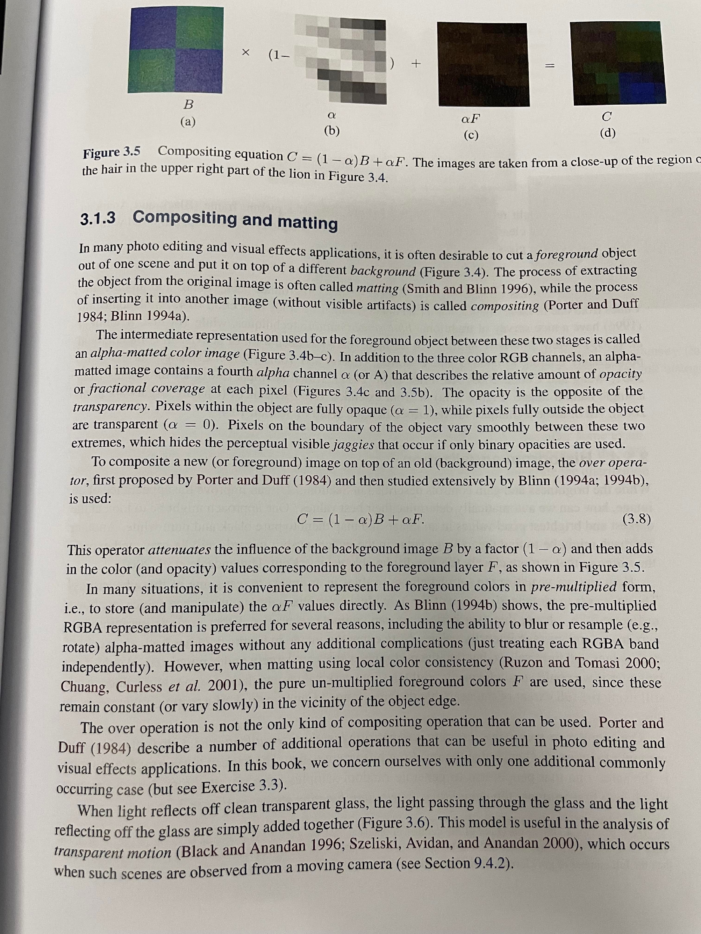

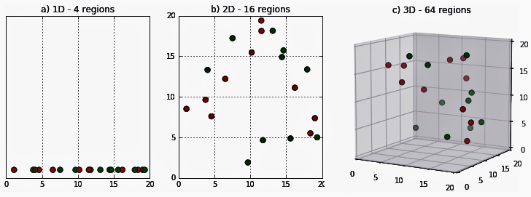

4.1 Curse of Dimensionality
When dimensionality increases, data becomes increasingly sparse in the space that it occupies.
May spend much time and memory required by data mining algorithms.
Hard to visualize.
‹#›

Slide 10
4.1 Introduction (Cont.)
Statistical pattern recognition techniques:
Feature selection and extraction techniques
Decision rule construction techniques
Techniques for estimating decision rule error
‹#›
Notes:
Feature selection and extraction 其實不會講到

Slide 11
Joke Time
‹#›

Slide 12
4.2 Recall Some Definitions
t: true category identification from set C
a: assigned category from set C
d: observed measurement from a set of measurements D
(t, a, d): event of classifying the observed unit
P(t, a, d): probability of the event (t, a, d)
e(t, a): economic gain with true category t and assigned category a
‹#›
Notes:
e: 經濟增益

Slide 13
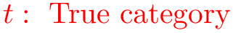
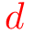
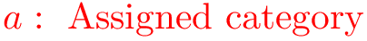
4.2 Recall
unit
measurement vector
(image regions or
projected segments)
decision rule
optimally assign unit to a class
‹#›

Slide 14
4.2 Economic Gain Matrix
correct
assign unit to a class
incorrect
Assigned State(a)
(t, a) | Good | Bad
Good | (g, g) | (g, b)
Bad | (b, g) | (b, b)
True State(t)
‹#›

Slide 15
4.2 Economic Gain Matrix (Cont.)
We assume that the act of making category assignments carries consequences (t, a, d) economically or in terms of utility.
e(t, a): economic gain/utility with true category t and assigned category a
‹#›
Notes:
Utility 效用

Slide 16
4.2 Economic Gain Matrix (Cont.)
Assigned State
e(t, a) | Good | Bad
Good | e(g, g) | e(g, b)
Bad | e(b, g) | e(b, b)
True State
‹#›

Slide 17
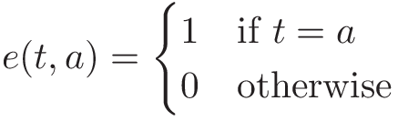
4.2 Economic Gain Matrix (Cont.)
Identity gain matrix
Assigned State
e(t, a) | Good | Bad
Good | 1 | 0
Bad | 0 | 1
True State
‹#›
Notes:
考慮一個理想的人，他總是希望給出最準確的判斷，他的Economic Gain Matrix，就是一個單位矩陣

Slide 18

4.2 Jet Fan Blade
‹#›
Notes:
以扇葉檢查為例

Slide 19
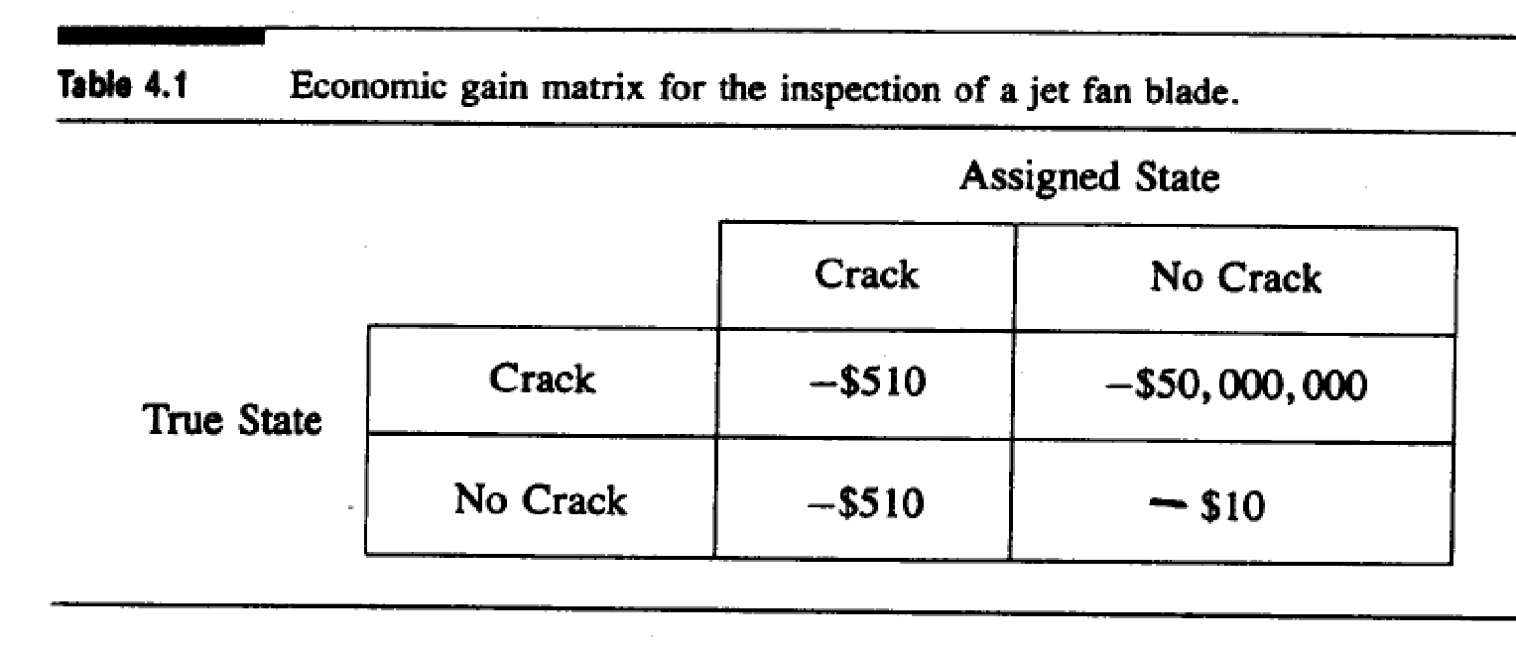
4.2 An Instance (Cont.)
‹#›
Notes:
風扇更換費 500
檢測費 10

Slide 20
Joke Time
‹#›

Slide 21
4.2 Some notation
P(g, g): probability of true good, assigned good,
P(g, b): probability of true good, assigned bad,
...
e(g, g): economic consequence for event (g, g),
…
e positive: profit consequence
e negative: loss consequence
‹#›

Slide 22
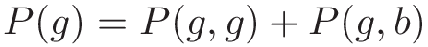
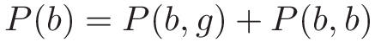
4.2 Expected profit per object
Fraction of good objects manufactured
Fraction of bad objects manufactured
Expected profit per object
‹#›
Notes:
9/29 教到這裡

Slide 23
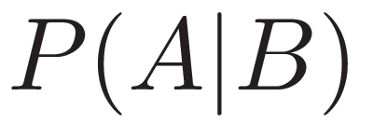
4.2 Conditional Probability
“Event that
already happened’’
“given’’
‹#›

Slide 24
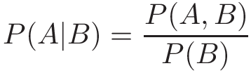
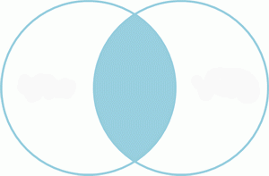
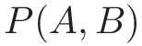
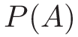
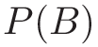
4.2 Conditional Probability (cont.)
‹#›

Slide 25
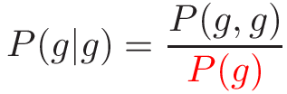

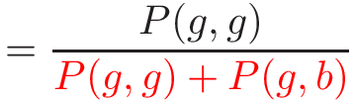
4.2 Conditional Probability (cont.)
Given that an object is good, the probability that it is detected as good:
“assigned’’
“true’’
“true’’
P(g, g)
P(g, b)
P(g)
‹#›
Notes:
差異
g|g: 真實為g的情況下被指派g的事件發生機率
g,g: 此determine rule將真實為g被指派為g的機率

Slide 26
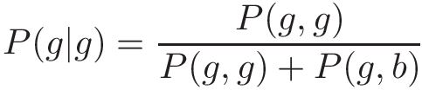
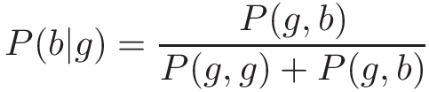
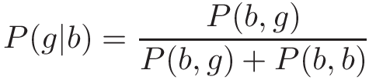
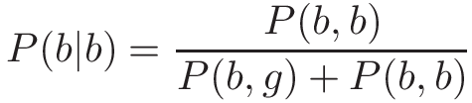
4.2 Conditional Probability (cont.)
TP: True Positive
TN: True Negative
FP: False Positive
FN: False Negative
TP
FN
FP
TN
‹#›
Notes:
True Positive

Slide 27
4.2 Conditional Probability (cont.)
The machine’s incorrect performance is characterized:
P(b | g): false-alarm rate (假警報率) FN, Type I Error
P(g | b): misdetection rate (漏檢率) FP, Type II Error
‹#›

Slide 28
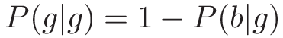
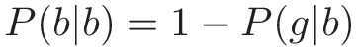
4.2 Conditional Probability (cont.)
From P(b | g) and P(g | b) the two other conditional probabilities P(g | g) and P(b | b) can be readily computed:
‹#›

Slide 29
4.2 Expected profit per object
Another formula for expected profit per object
Recall
‹#›

Slide 30
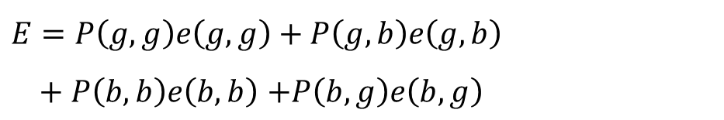
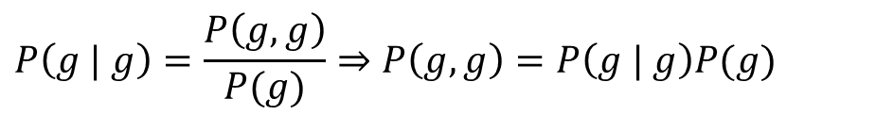
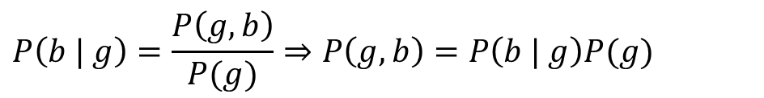
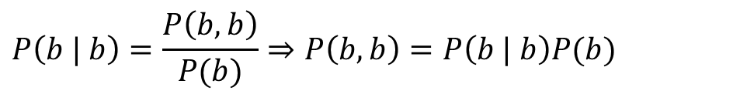
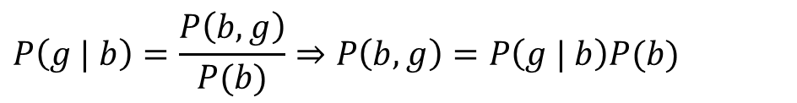
4.2 Expected profit per object
‹#›

Slide 31
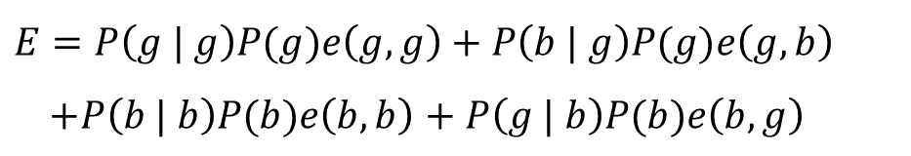
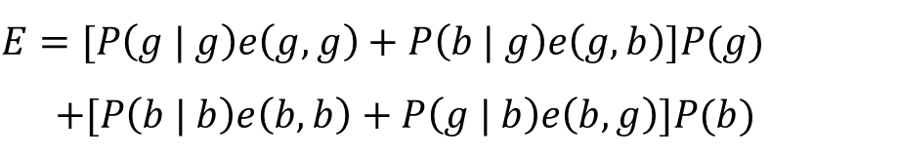
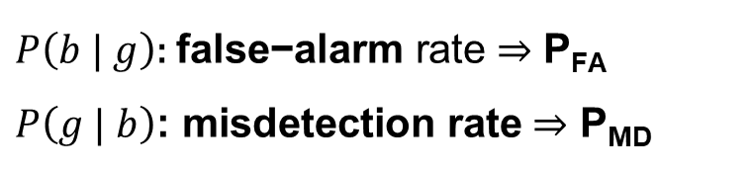
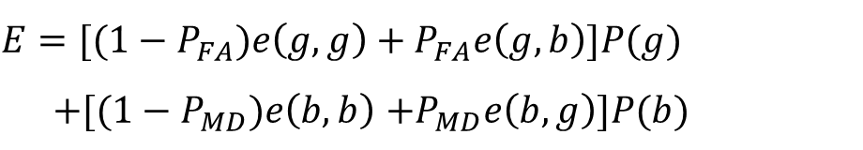
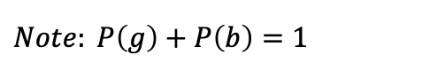
4.2 Expected profit per object
‹#›

Slide 32
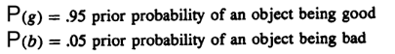
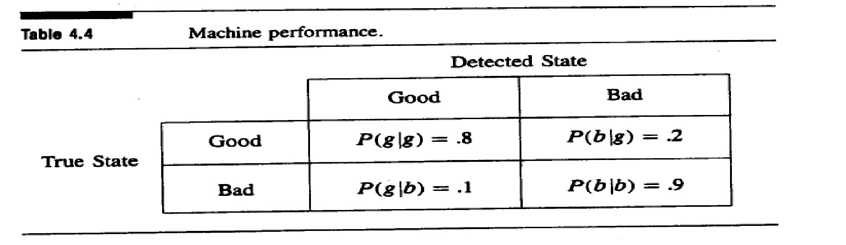
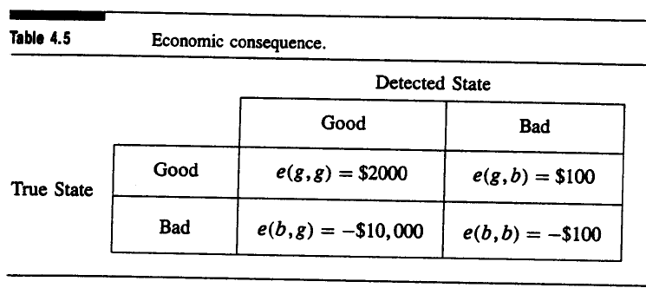
4.2 Example 4.1
‹#›

Slide 33
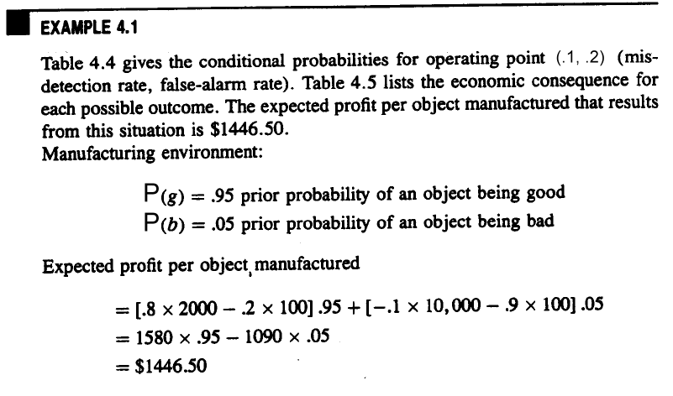
4.2 Example 4.1 (cont.)
 | Good | Bad
Good | P(g | g) = 0.8 | P(b | g) = 0.2
Bad | P(g | b) = 0.1 | P(b | b) = 0.9
 | Good | Bad
Good | e(g, g) = $2000 | e(g, b) = -$100
Bad | e(b, g) = -$10,000 | e(b, b) = -$100
‹#›
Notes:
系統嚴格的例子
*題可看

Slide 34
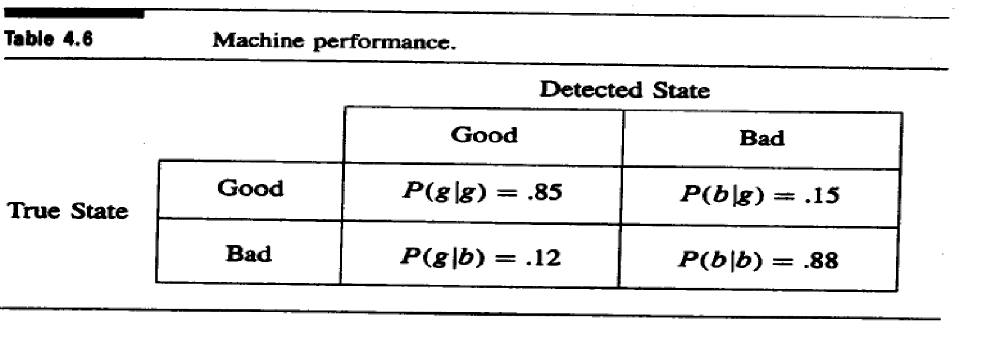
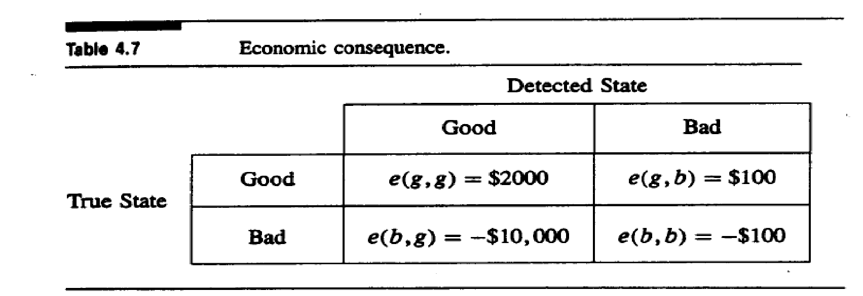
4.2 Example 4.2
‹#›

Slide 35
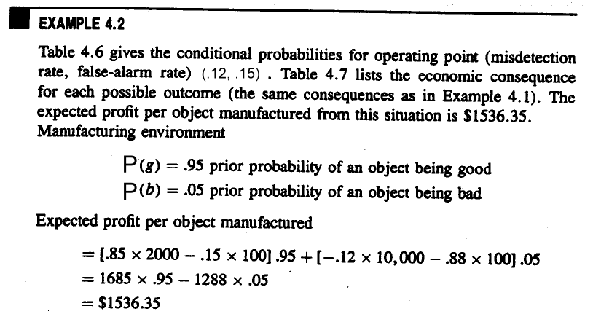
4.2 Example 4.2 (cont.)
 | Good | Bad
Good | P(g | g) = 0.85 | P(b | g) = 0.15
Bad | P(g | b) = 0.12 | P(b | b) = 0.88
 | Good | Bad
Good | e(g, g) = $2000 | e(g, b) = -$100
Bad | e(b, g) = -$10,000 | e(b, b) = -$100
‹#›
Notes:
系統寬鬆的例子

Slide 36
Joke Time
‹#›

Slide 37
4.2 Recall
How to reduce the dimensionality?
Feature selection and extraction
unit
measurement vector
(image regions or
projected segments)
Construction techniques
decision rule
Estimation of error
optimally assign unit to a class
‹#›

Slide 38
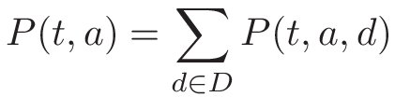
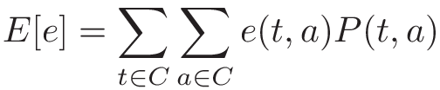
4.2 Decision Rule Construction
(t, a): summing (t, a, d) on every measurement d
Therefore,
Average economic gain
‹#›
Notes:
(t, a, d): event of classifying the observed unit
把P(t,a)理解成一個矩陣的element(下一頁)

Slide 39
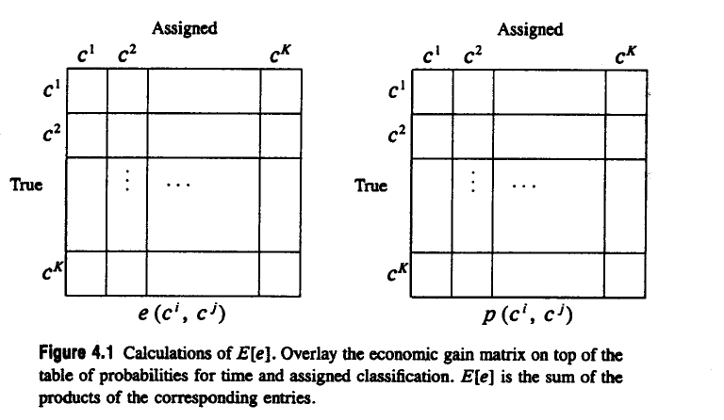
4.2 Decision Rule Construction (cont.)
‹#›

Slide 40
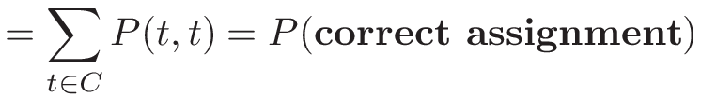
4.2 Decision Rule Construction (cont.)
We can use identity matrix as the economic gain matrix to compute the probability of correct assignment:
‹#›

Slide 41
4.2 Decision Rule Construction (cont.)
1
0
0
0
1
0
0
0
1
true
‹#›

Slide 42
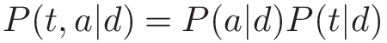
4.2 Fair Game Assumption
Decision rule uses only measurement data in assignment; the nature (true category identification) and the decision rule (assigned category identification) are not in collusion.
In other words,
Fair Game Assumption: P(a | t, d) = P(a | d)
=>
“given t ’’
‹#›
Notes:
Collusion 共謀
即便給予t, decision rule的行為機率也要和沒給t時相同

Slide 43
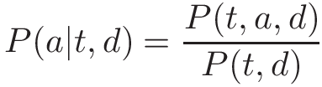
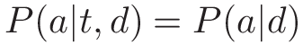
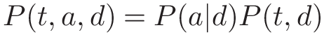
4.2 Fair Game Assumption (cont.)
From the definition of conditional probability
Fair game assumption:
So
‹#›

Slide 44
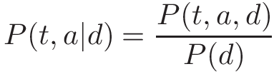
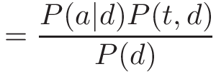


4.2 Fair Game Assumption (cont.)
By fair game assumption,
By definition,
Note:
‹#›

Slide 45
4.2 Fair Game Assumption (cont.)
The fair game assumption leads to the fact that conditioned on measurement d, the true category and the assigned category are independent.
‹#›
Notes:
Assigned 跟 truth category是獨立的

Slide 46
4.2 Fair Game Assumption (cont.)
P(t | d): a conditional probability that nature
determines.
P(a | d): decision rule assigns category a to an observed unit having measurement d.
In order to distinguish them, we will use
f(a | d) for the conditional probability
associated with the decision rule.
‹#›
Notes:
P104(P117)

Slide 47

4.2 Deterministic Decision Rule
We use the notation f(a | d) to completely define a decision rule; f(a | d) presents all the conditional probability associated with the decision rule.
A deterministic decision rule:
Decision rules which are not deterministic are called probabilistic/nondeterministic/stochastic.
‹#›
Notes:
Deterministic Decision Rule 確定性決策規則

Slide 48






4.2 Expected Value on f(a|d)
Previous formula
By and
=>
‹#›

Slide 49




4.2 Expected Value on f(a|d) (cont.)
To analyze the dependence has on :
regroup
‹#›

Slide 50

4.2 Maximizing Expected Economic Gain (cont.)
Maximize expected economic gain
Satisfy
for any decision rule g
Constructing the optimal f
‹#›

Slide 51
4.2 Maximizing Expected Economic Gain (cont.)
How to Maximize expected economic gain?
‹#›

Slide 52

4.2 Maximizing Expected Economic Gain (cont.)
Split by the first summation:
Set
Maximize when each term meets its own maximum
‹#›

Slide 53




4.2 Maximizing Expected Economic Gain (cont.)
Set
Note:
Choose
“decision rule’’
Bayes decision rule
‹#›

Slide 54


4.2 Discrete Example
‹#›
Notes:
Bayes’rule 要把結果全部assign給機率最高的類別
*題可看

Slide 55
4.2 Discrete Example
‹#›
Notes:
看行(直得看)
Economic gain matrix 乘 conditional probability matrix ， 位置應該交換較直觀 ， 但課本原圖就長這樣

Slide 56




4.2 Discrete Example (cont.)
Calculate accuracy and error of the decision rule constructed.
+
+
‹#›
Notes:
(t,a): summing (t, a, d) on every measurement d
(p.36)

Slide 57
Joke Time
‹#›

Slide 58




4.3 Prior Probability
The Bayes rule:
Replace with
The Bayes rule can be determined by assigning any categories that maximizes
‹#›
Notes:
用 prior probability (事前機率) 的觀點來看 Bayes rule
\sum_{t \in C} e(t, a)P(d|t)P(t) 這個形式是有用的
因為能把 P(t) 這個 Prior Probability 抽出
Likelihood function: 在已知某個母數B時，事件A會發生的機率，在這種意義上，概似函數可以理解為條件機率的逆反。

Slide 59




4.3 Prior Probability (cont.)
If the economic gain matrix is the identity matrix and choose all the category prior probabilities to be equal. Therefore,
The Bayes rule:
Likelihood function
It’s called maximum likelihood decision rule.
‹#›
Notes:
P110(P123)

Slide 60



4.2 Continuous Measurement
Recall that
Discrete Measurement:
Continuous Measurement:
‹#›

Slide 61




4.2 Continuous Measurement (cont.)
Note: by Fair Game Assumption
‹#›

Slide 62

4.2 Continuous Measurement (cont.)
Choose
continuous measurement
‹#›

Slide 63







4.2 Continuous Example (cont.)
Suppose that the prior probability of
is and the prior probability of is
and using an identity economic gain matrix
continuous density function of the measurements and
Note:
‹#›
Notes:
x: measurement

Slide 64




4.2 Continuous Example (cont.)
When , a Bayes decision rule will assign an observed unit to t₁, which implies
When , a Bayes decision rule will assign an observed unit to t₂, which implies
‹#›

Slide 65


4.2 Continuous Example (cont.)
Bayes decision rule:
Choose
and
‹#›

Slide 66


4.2 Continuous Example (cont.)
By definition
Since economic gain is identity matrix:
‹#›

Slide 67





4.2 Continuous Example (cont.)
‹#›

Slide 68




4.2 Continuous Example
For the example, try the continuous density function of the measurements:
and
Prove that they are indeed density function
‹#›
Notes:
Possible measurements x lie in the closed interval [0, 1]
P(x|t_1) = 3x^2
P(x|t_2) = 3(1-x^2)/2

Slide 69



4.4 Economic Gain Matrix
Suppose e₁(t, a) and e₂(t, a) are two different economic gain functions
This inequality is inequality to
for every
for every
‹#›
Notes:
看不同的 economic gain matrix 對於 decision rule 的影響
證明兩 economic gain matrix 若互為線性組合只差一個常數或正係數，這樣 bayes decision rule求出最大經濟增長期望值的a類別會相同
最大增益值出現在a

Slide 70





4.4 Economic Gain Matrix (cont.)
for every
remove from both sides
for every
for every
‹#›
Notes:
有一樣的 decision rule，因常數和係數都能被提出消掉

Slide 71




4.4 Economic Gain Matrix
Identity matrix
Incorrect loses 1
A more balanced instance
General
‹#›
Notes:
Incorrect loses 1: 1*I-1
A more balanced instance: 2*I-1
可能會認為 Incorrect loses 1 跟 Correct +1 Incorrect-1 一樣是因為獎懲值一樣所以才一樣
General case = (x+y)*I – y

Slide 72
Joke Time
‹#›

Slide 73
4.5 Maximin Decision Rule
In order to determine a Bayes decision rule, we have to know the joint function f(t, d) or at least f(d | t)
To determine f(t, d) from f(d | t), we must also know the prior probability function P(t)
Bayes decision is not appropriate for the situation can not get or assume the prior probability function
‹#›
Notes:
f(c, d)在measurement是d的情況下，unit指定為c的機率

Slide 74


4.5 Maximin Decision Rule
Maximum of Minimum
Define the conditional expected economic gain:
A decision rule f called a maximin decision rule if and only if
for any decision rule g
‹#›
Notes:
E[e|c^{j}; f] 為 在 t=c^{j} 的情況下 f 的expected economic gain
Maximin decision的意思是，要最大化所有可能的真實情況 c^{j} 中，最小的那個

Slide 75









4.5 Maximin Decision Rule (cont.)
Hence and , suppose that , and choose
for any decision rule g
‹#›

Slide 76

4.5 Maximin Decision Rule (cont.)
If economic gain matrix is identity matrix
‹#›

Slide 77

4.5 Example 4.3
Consider the case where there are two categories c¹ and c²; three possible measurements d¹, d², and d³; economic gain matrix is identity matrix, and a conditional probability function f(d | c) given by
‹#›

Slide 78




4.5 Example 4.3 (cont.)
Measurements
Maximin
Decision Rule
‹#›
Notes:
有兩個 Maximin Decision Rule

Slide 79



4.5 Example 4.3 (cont.)
Measurements
P(c²)
E[e|c²;f]
E[e|c¹;f]
‹#›

Slide 80






4.5 Example 4.3 (cont.)
,
The lowest Bayes gain is achieved when
and
‹#›
Notes:
這裡要說明一個 maximin 的性質:
Bayes decision rule 的 economic gain 值得最小值，就會剛好是 miximin decision rule 對應的 economic gain值
nondeterministic

Slide 81
4.5 Example 4.3 (cont.)
0.6714
‹#›

Slide 82

4.5 Example 4.3 (cont.)
‹#›
Notes:
Miximin 發生在 stochastic decision (nondeterministic)

Slide 83


4.5 Example 4.4
Function f(d | c) is:
Economic gain matrix e is:
‹#›

Slide 84



4.5 Example 4.4 (cont.)
‹#›

Slide 85


4.5 Example 4.4 (cont.)
‹#›

Slide 86


4.5 Example 4.4 (cont.)
‹#›

Slide 87


4.5 Example 4.4 (cont.)
‹#›

Slide 88


4.5 Example 4.4 (cont.)
Maximin
Decision Rule
‹#›

Slide 89


4.5 Example 4.4 (cont.)
‹#›

Slide 90


4.5 Example 4.4 (cont.)
‹#›

Slide 91


4.5 Example 4.4 (cont.)
‹#›

Slide 92
4.5 Example 4.4 (cont.)
Maximin
Decision Rule
‹#›

Slide 93

4.5 Example 4.4 (cont.)
‹#›

Slide 94

4.5 Example 4.4 (cont.)
‹#›

Slide 95
Joke Time
‹#›

Slide 96


4.6 Decision Rule Error
The misidentification error αk
The false-identification error βk
‹#›

Slide 97








4.6 An Instance
‹#›

Slide 98
4.7 Reserving Judgment
Reserved judgment gives the decision rule one more option
Instead of giving assignments for every measurements d
The decision rule may opt to withhold judgment for some measurement
‹#›
Notes:
*考名詞解釋
保留的判斷為決策規則提供了另一種選擇
1. Reserved judgment可有效控制誤差率
2. 對於某些測量值，決策準則可能會抑制到某些判定結果。
3. 決策準則被對於那些它指定的測量值所抑制的判定結果和誤差率的時間比率所描述

Slide 99

4.8 Nearest Neighbor Rule
Assign pattern x to the closest vector in the training set
The definition of “closest”:
where is a metric or measurement space
Chief difficulty: brute-force nearest neighbor algorithm computational complexity proportional to number of patterns in training set
‹#›
Notes:
brute-force nearest neighbor:暴力法

Slide 100

4.9 Binary Decision Tree Classifier
Assign by hierarchical decision procedure
‹#›
Notes:
Leaf: assign的類別
Node: decision rule

Slide 101
4.9 Major Problems
Choosing tree structure
Choosing features used at each non-terminal node
Choosing decision rule at each non-terminal node
‹#›

Slide 102
4.9 Decision Rules at the Non-terminal Node
Thresholding the measurement component
Fisher’s linear decision rule
Bayes quadratic decision rule
Bayes linear decision rule
Linear decision rule from the first principal component
‹#›
Notes:
We can use any one of the following five decision rules at each nonterminal node
參考就好

Slide 103
4.10 Error Estimation
An important way to characterize the performance of a decision rule
Training data set: must be independent of testing data set
Hold-out method: a common technique
construct the decision rule with half the data set, and test with the other half
‹#›

Slide 104

4.11 Neural Network
A set of units each of which takes a linear combination of values from either an input vector or the output of other units
‹#›

Slide 105
4.12 Summary
Bayesian approach
Maximin decision rule
Misidentification and false-alarm error rates
Nearest neighbor rule
Construction of decision trees
Estimation of decision rules error
Neural network
‹#›

